Slide 1
What is an angle?
An angle is the amount of rotation applied to a ray.
Terminal Side
Vertex
Initial Side

Slide 2
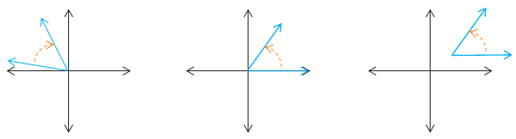
Angle Facts
Facts about angle rotation
The amount of the rotation is unrestricted.
A positive angle represents counterclockwise rotation.
A negative angle represents clockwise rotation.
An angle is in standard position if the vertex is at the origin and the initial side is along the positive x-axis.

Slide 3

Degrees
A degree (°) is the amount of angular rotation equal to $\frac{1}{360}$ of a complete revolution.
What does 90° represent?
Draw the following angles: 90°, 45°, 300°, -150°

Slide 4



Radians
A radian is the amount of angular rotation for a point on the circle that traces an arc having a length equal to the radius.
$$r$$
1
1
1 rad
1
0
$$π$$
$$r$$

Slide 5

Radian Angles
A half-circle rotation is $π$ radians.
What does $\frac{π}{2}$ represent?
Draw the following angles: $2π$, $−3π$ , $\frac{3π}{4}$

Slide 6

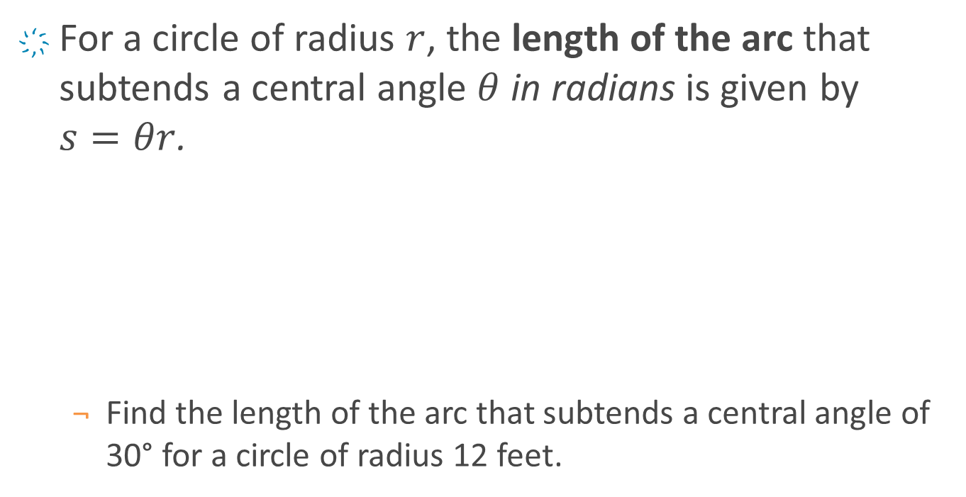


Arc Length
For a circle of radius $r$, the length of the arc that subtends a central angle $θ$ in radians is given by $s=θr$.
Find the length of the arc that subtends a central angle of 30° for a circle of radius 12 feet.
$$s$$
$$θ$$
$$r$$

Slide 7

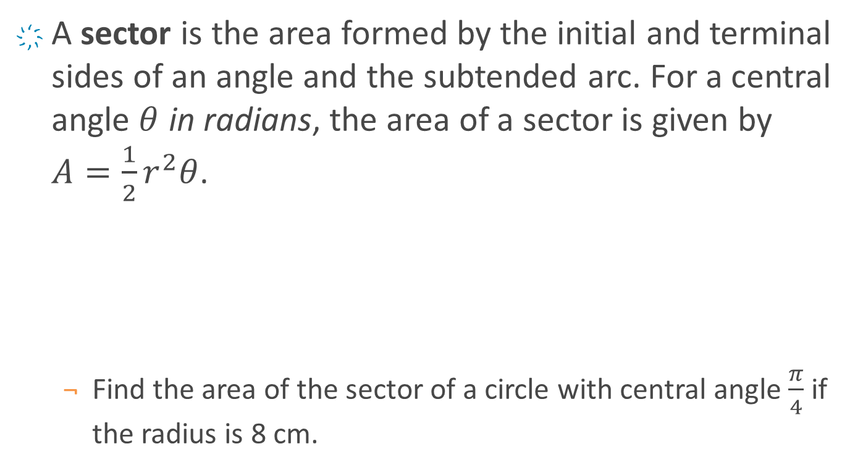

Sector Area
A sector is the area formed by the initial and terminal sides of an angle and the subtended arc. For a central angle $θ$ in radians, the area of a sector is given by $A=\frac{1}{2}r^{2}θ$.
Find the area of the sector of a circle with central angle $\frac{π}{4}$ if the radius is 8 cm.
$$θ$$
$$r$$

Slide 8



Linear & Angular Speed
When an object travels around a circular path, there are two speeds that can be measured.
Linear speed is the rate at which the object travels along the arc and is measured in units of length per unit of time.
Angular speed is the rate at which the object rotates about its vertex and is measured in radians per unit of time.
Linear Speed: $v=\frac{s}{t}$
Angular Speed: $ω=\frac{θ}{t}$
$v=rω$
$$s$$
$$θ$$

Slide 9

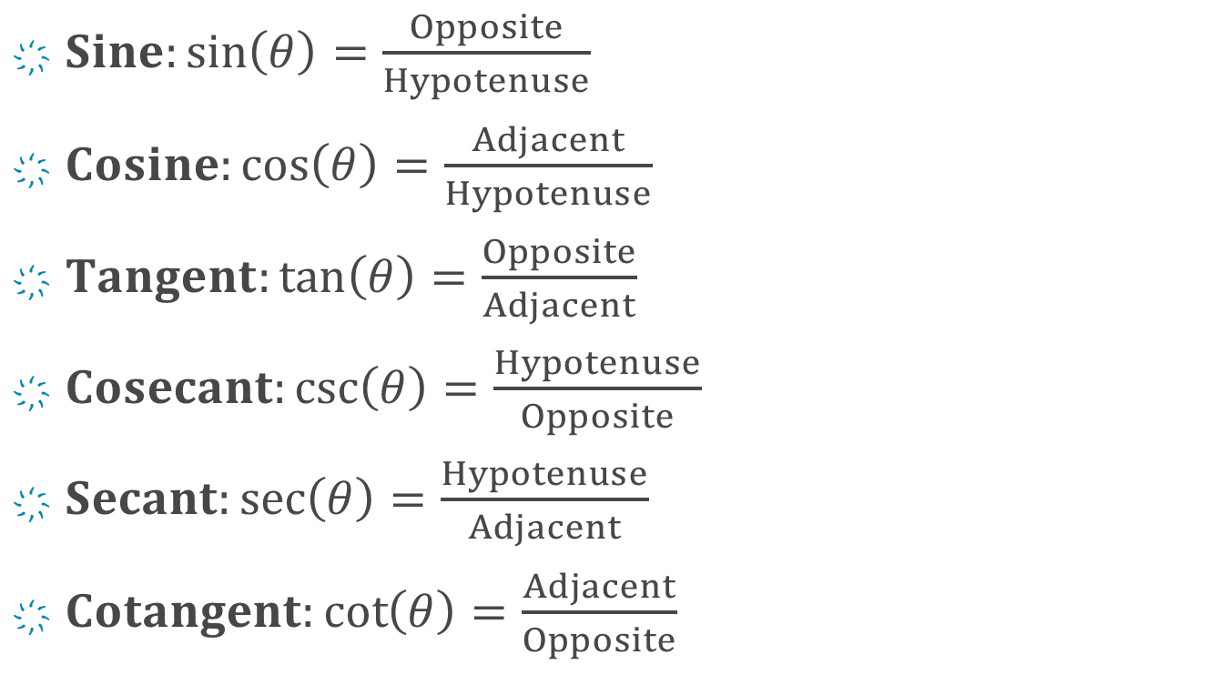

The 6 Trig Functions - SOHCAHTOA
$Sine:\sin\left(θ\right)=\frac{Opposite}{Hypotenuse}$
$Cosine:\cos\left(θ\right)=\frac{Adjacent}{Hypotenuse}$
$Tangent:\tan\left(θ\right)=\frac{Opposite}{Adjacent}$
$Cosecant:\csc\left(θ\right)=\frac{Hypotenuse}{Opposite}$
$Secant:\sec\left(θ\right)=\frac{Hypotenuse}{Adjacent}$
$Cotangent:\cot\left(θ\right)=\frac{Adjacent}{Opposite}$
Hypotenuse
Opposite
$$θ$$
Adjacent
$$θ$$
Hypotenuse
Adjacent
Opposite

Slide 10


SOHCAHTOA
Determine the exact value of the six trig functions.
Given the triangle below.
If $\cos{θ}=\frac{8}{17}$ for an acute angle $θ$ in a right triangle.
12
9
$$θ$$

Slide 11
SOHCAHTOA – Using Technology
Find the approximate value of x.
25
53°
x

Slide 12








Find the unknown sides and angles
30-60-90 Triangle
45-45-90 Triangle
$$B$$
$$B$$
1
$$a$$
1
$$a$$
$$b$$
$$A$$
$$A$$
$$b$$

Slide 13





SOHCAHTOA – 30° Angles
Compute the following:
sin(30°)
cos(30°)
tan(30°)
30°
45°
$$\frac{\sqrt{3}}{2}$$
1
$$\frac{\sqrt{2}}{2}$$
$$1$$
60°
45°
$$\frac{1}{2}$$
$$\frac{\sqrt{2}}{2}$$

Slide 14
SOHCAHTOA – 60° Angles
Compute the following:
sin(60°)
cos(60°)
tan(60°)
30°
45°
$$\frac{\sqrt{3}}{2}$$
1
$$\frac{\sqrt{2}}{2}$$
$$1$$
60°
45°
$$\frac{1}{2}$$
$$\frac{\sqrt{2}}{2}$$

Slide 15

SOHCAHTOA – 45° Angles
Compute the following:
sin(45°)
cos(45°)
tan(45°)
30°
45°
$$\frac{\sqrt{3}}{2}$$
1
$$\frac{\sqrt{2}}{2}$$
$$1$$
60°
45°
$$\frac{1}{2}$$
$$\frac{\sqrt{2}}{2}$$

Slide 16
Using 30-60-90
Find the exact value of x.
5
30°
x

Slide 17
Using 45-45-90
Solve ΔABC. (Hint: to solve a triangle means to find all the missing sides and angles.)
A
34
45°
B
C

Slide 18

Using Radians
Compute the following values.
$\sin\left(\frac{π}{6}\right)$
$\tan\left(\frac{π}{3}\right)$
$\sec\left(\frac{π}{4}\right)$
30°
45°
$$\frac{\sqrt{3}}{2}$$
1
$$\frac{\sqrt{2}}{2}$$
$$1$$
60°
45°
$$\frac{1}{2}$$
$$\frac{\sqrt{2}}{2}$$

Slide 19
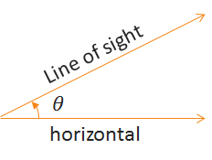
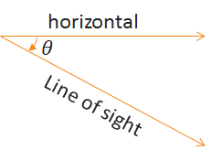
Line of Sight
Angle of Elevation
Angle of Depression

Slide 20



Unit Circle
A circle centered at the origin with radius of 1.
$$y$$
$$r=1$$
$$x$$

Slide 21





Points along the Unit Circle
Every point $P$ on the unit circle can be associated with a real number $t$ that represents the arc length from the positive $x$-axis. Point $P$ can also be associated with the intersection of the terminal side of a central angle $θ$ and the unit circle.
We call $P$ a terminal point.
We call $t$ a terminal number.
Given $s=θr$ and $r=1$, we know that $t=θ$.
$$P$$
$$t$$
$$θ$$
$$r=1$$

Slide 22















Rotation Equals Distance
By applying the definition of radian measure, we can determine the coordinates at specific distances.
$$P$$
$$t=0$$
$$t=π$$
$$t$$
$$t$$
$$\left(1, 0\right)$$
$$\left(−1, 0\right)$$
$$\left(0, 1\right)$$
$$\left(\frac{\sqrt{2}}{2},\frac{\sqrt{2}}{2}\right)$$
$$t=\frac{π}{2}$$
$$x$$
$$x$$
$$t=\frac{π}{4}$$
$$t=−\frac{π}{2}$$
$$\left(0, −1\right)$$

Slide 23











Special Triangles & the Unit Circle
Combine our special triangles with the unit circle.
$$\left(\frac{1}{2},\frac{\sqrt{3}}{2}\right)$$
$$\left(\frac{\sqrt{2}}{2},\frac{\sqrt{2}}{2}\right)$$
$$1$$
$$1$$
$$\frac{\sqrt{3}}{2}$$
$$\frac{\sqrt{2}}{2}$$
45°
60°
$$\frac{\sqrt{2}}{2}$$
$$\frac{1}{2}$$
$$\left(\frac{\sqrt{3}}{2},\frac{1}{2}\right)$$
$$1$$
$$\frac{1}{2}$$
30°
$$\frac{\sqrt{3}}{2}$$

Slide 24


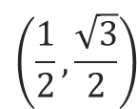

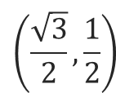



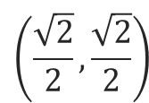

Coordinates in the First Quadrant
These are the coordinates in the first quadrant that we get for special $t$ or $θ$ values.
Verify that $\left(\frac{\sqrt{3}}{2},\frac{1}{2}\right)$ is on the unit circle.
$$\left(0, 1\right)$$
$$\left(\frac{1}{2},\frac{\sqrt{3}}{2}\right)$$
90° = $\frac{π}{2}$
$$\left(\frac{\sqrt{2}}{2},\frac{\sqrt{2}}{2}\right)$$
60° = $\frac{π}{3}$
45° = $\frac{π}{4}$
$$\left(\frac{\sqrt{3}}{2},\frac{1}{2}\right)$$
30° = $\frac{π}{6}$
0° = 0
$$\left(1, 0\right)$$

Slide 25












Trig Functions & the Unit Circle
How does this all relate to our trig functions?
Conclusion: $\sin{θ}=y$, $\cos{θ}=x$, and $\tan{θ}=\frac{y}{x}$
$$\left(x,y\right)$$
$$Hyp$$
$$1$$
$$\frac{Opp}{Hyp}$$
$$=\sin{θ}=y$$
$$Opp$$
$$θ$$
$$θ$$
$$Adj$$
$$\frac{Adj}{Hyp}$$
$$=\cos{θ}=x$$

Slide 26




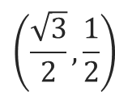



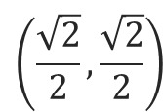

Examples: Trig Functions & the Unit Circle
Compute the following.
$\sin\left(30°\right)$
$\cos\left(45°\right)$
$\tan\left(\frac{π}{6}\right)$
$\sin\left(\frac{π}{2}\right)$
$$\left(0, 1\right)$$
$$\left(\frac{1}{2},\frac{\sqrt{3}}{2}\right)$$
90° = $\frac{π}{2}$
$$\left(\frac{\sqrt{2}}{2},\frac{\sqrt{2}}{2}\right)$$
60° = $\frac{π}{3}$
45° = $\frac{π}{4}$
$$\left(\frac{\sqrt{3}}{2},\frac{1}{2}\right)$$
30° = $\frac{π}{6}$
0° = 0
$$\left(1, 0\right)$$

Slide 27


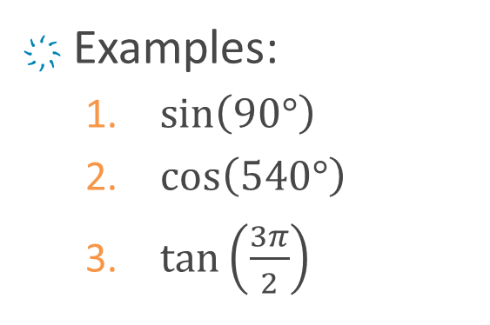



Quadrantal Angles
How can we expand this beyond acute angles in the first quadrant?
Quadrantal angles
Quadrant signs
Reference angles
Angle location
$$\left(0, 1\right)$$
$$θ$$
$$\left(−1,0\right)$$
$$\left(1, 0\right)$$
Examples:
$\sin\left(90°\right)$
$\cos\left(540°\right)$
$\tan\left(\frac{3π}{2}\right)$
$$\left(0, −1\right)$$

Slide 28

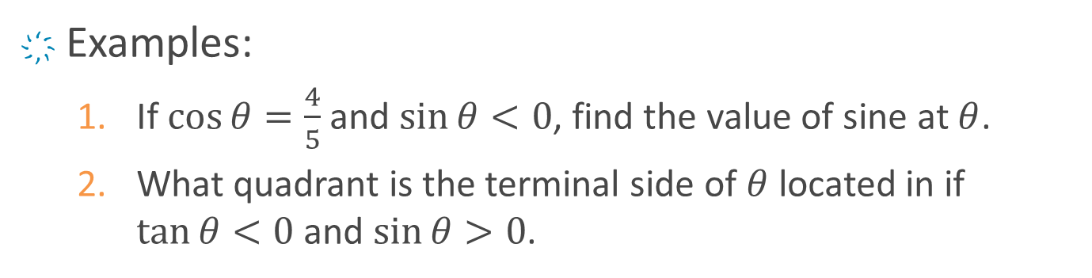
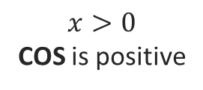
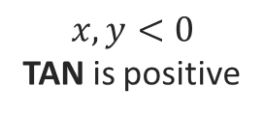
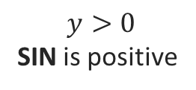
Quadrant Signs
How can we expand this beyond acute angles in the first quadrant?
Quadrantal angles
Quadrant signs
Reference angles
Angle location
$$y>0$$
SIN is positive
$$x,y>0$$
ALL are positive
$$x,y<0$$
TAN is positive
$$x>0$$
COS is positive
Examples:
If $\cos{θ}=\frac{4}{5}$ and $\sin{θ}<0$, find the value of sine at $θ$.
What quadrant is the terminal side of $θ$ located in if $\tan{θ}<0$ and $\sin{θ}>0$.

Slide 29
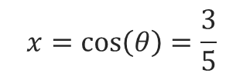


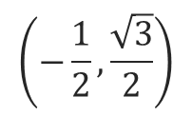


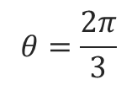




$$\left(−\frac{1}{2},\frac{\sqrt{3}}{2}\right)$$
$$θ=\frac{2π}{3}$$
$$\left(x,y\right)$$
$$1$$
$$y=\sin\left(θ\right)$$
$$θ$$
$$1$$
$$y$$
$$x=\cos\left(θ\right)=\frac{3}{5}$$
$$θ=−\frac{2π}{3}$$
$$θ$$
$$\left(−\frac{1}{2},−\frac{\sqrt{3}}{2}\right)$$
$$x$$

Slide 30

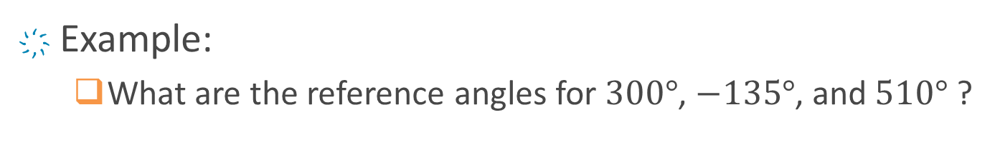



Reference Angles
How can we expand this beyond acute angles in the first quadrant?
Quadrantal angles
Quadrant signs
Reference angles
Angle location
B
A
$$\overline{θ}$$
$$θ$$
$$\overline{θ}$$
$$\overline{θ}$$
C
D
Example:
What are the reference angles for $300°$, $−135°$, and $510°$ ?

Slide 31





Dividing the Unit Circle by $\frac{π}{2}$
$$\frac{1π}{2}$$
$$\frac{2π}{2}$$
$$\frac{0π}{2}$$
$$\frac{4π}{2}$$
$$\frac{3π}{2}$$

Slide 32







Dividing the Unit Circle by $\frac{π}{3}$
$$\frac{2π}{3}$$
$$\frac{1π}{3}$$
$$\frac{3π}{3}$$
$$\frac{0π}{3}$$
$$\frac{6π}{3}$$
$$\frac{4π}{3}$$
$$\frac{5π}{3}$$

Slide 33
Dividing the Unit Circle by $\frac{π}{4}$

Slide 34
Dividing the Unit Circle by $\frac{π}{6}$

Slide 35













Reference Numbers
For each terminal point $P$ along the unit circle, there is a reference number $\overline{t}$, where $0≤\overline{t}≤\frac{π}{2}$, that gives the shortest distance from $P$ to the $x$-axis.
Note that $\overline{t}=\overline{θ}$.
$$P\left(x,y\right)$$
$$P\left(x,y\right)$$
$$t$$
$$t$$
$$\overline{t}$$
$$t$$
$$\overline{t}$$
$$\overline{t}$$
$$\overline{t}$$
$$P\left(x,y\right)$$
$$t$$
$$P\left(x,y\right)$$

Slide 36





Points on the Unit Circle
Locate each point and identify its reference number.
$t=\frac{2π}{3}$
$t=\frac{3π}{4}$
$t=\frac{5π}{6}$
$t=\frac{7π}{4}$
$t=−\frac{4π}{3}$
$t=−\frac{11π}{6}$
$t=\frac{11π}{3}$
$$\frac{π}{2}$$
$$\frac{π}{3}$$
$$\frac{π}{4}$$
$$\frac{π}{6}$$

Slide 37

































Symmetry of the Unit Circle
$$\left(−\frac{1}{2},\frac{\sqrt{3}}{2}\right)$$
$$\left(0,1\right)$$
$$\left(\frac{1}{2},\frac{\sqrt{3}}{2}\right)$$
$$\left(−\frac{\sqrt{2}}{2},\frac{\sqrt{2}}{2}\right)$$
$$\frac{π}{2}$$
$$\left(\frac{\sqrt{2}}{2},\frac{\sqrt{2}}{2}\right)$$
$$\frac{2π}{3}$$
$$\frac{π}{3}$$
$$\frac{3π}{4}$$
$$\frac{π}{4}$$
$$\left(\frac{\sqrt{3}}{2},\frac{1}{2}\right)$$
$$\left(−\frac{\sqrt{3}}{2},\frac{1}{2}\right)$$
$$\frac{5π}{6}$$
$$\frac{π}{6}$$
$$\left(−1,0\right)$$
$$π$$
$$0$$
$$\left(1,0\right)$$
$$2π$$
$$\left(−\frac{\sqrt{3}}{2},−\frac{1}{2}\right)$$
$$\frac{7π}{6}$$
$$\frac{11π}{6}$$
$$\left(\frac{\sqrt{3}}{2},−\frac{1}{2}\right)$$
$$\frac{5π}{4}$$
$$\frac{7π}{4}$$
$$\left(−\frac{\sqrt{2}}{2},−\frac{\sqrt{2}}{2}\right)$$
$$\frac{4π}{3}$$
$$\frac{5π}{3}$$
$$\frac{3π}{2}$$
$$\left(\frac{\sqrt{2}}{2},−\frac{\sqrt{2}}{2}\right)$$
$$\left(−\frac{1}{2},−\frac{\sqrt{3}}{2}\right)$$
$$\left(\frac{1}{2},−\frac{\sqrt{3}}{2}\right)$$
$$\left(0,−1\right)$$

Slide 38

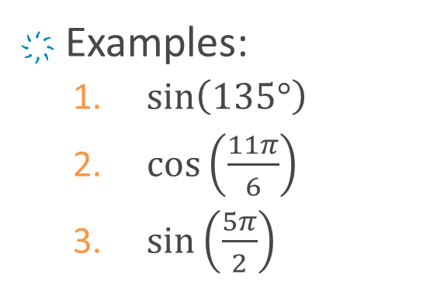
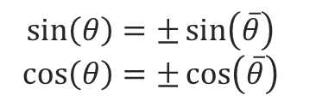


Sine & Cosine At Any Angle Location
How can we expand this beyond acute angles in the first quadrant?
Quadrantal angles
Quadrant signs
Reference angles
Angle location
$$\left(x,y\right)$$
$$θ$$
$$\overline{θ}$$
$$\sin\left(θ\right)=±\sin\left(\overline{θ}\right)$$
$$\cos\left(θ\right)=±\cos\left(\overline{θ}\right)$$
Examples:
$\sin\left(135°\right)$
$\cos\left(\frac{11π}{6}\right)$
$\sin\left(\frac{5π}{2}\right)$

Slide 39


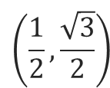

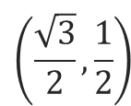



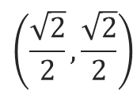

The Unit Circle: More Examples
Compute the following.
$\cos\left(210°\right)$
$\sin\left(−\frac{3π}{4}\right)$
$\cos\left(\frac{5π}{3}\right)$
$$\left(0, 1\right)$$
$$\left(\frac{1}{2},\frac{\sqrt{3}}{2}\right)$$
90° = $\frac{π}{2}$
$$\left(\frac{\sqrt{2}}{2},\frac{\sqrt{2}}{2}\right)$$
60° = $\frac{π}{3}$
45° = $\frac{π}{4}$
$$\left(\frac{\sqrt{3}}{2},\frac{1}{2}\right)$$
30° = $\frac{π}{6}$
0° = 0
$$\left(1, 0\right)$$

Slide 40

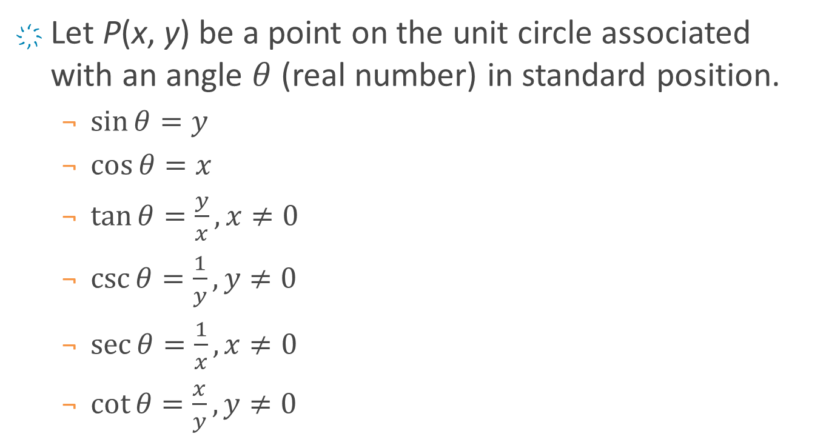

Unit Circle for Other Functions
Let P(x, y) be a point on the unit circle associated with an angle $θ$ (real number) in standard position.
$\sin{θ}=y$
$\cos{θ}=x$
$\tan{θ}=\frac{y}{x}, x≠0$
$\csc{θ}=\frac{1}{y},y≠0$
$\sec{θ}=\frac{1}{x},x≠0$
$\cot{θ}=\frac{x}{y},y≠0$
$$P\left(x,y\right)$$
$$θ$$

Slide 41


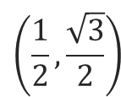

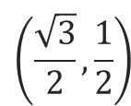



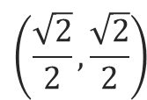

The Unit Circle: Other Trig Functions
Compute the following.
$\csc\left(30°\right)$
$\sec\left(−\frac{π}{4}\right)$
$\cot{\frac{π}{3}}$
$$\left(0, 1\right)$$
$$\left(\frac{1}{2},\frac{\sqrt{3}}{2}\right)$$
90° = $\frac{π}{2}$
$$\left(\frac{\sqrt{2}}{2},\frac{\sqrt{2}}{2}\right)$$
60° = $\frac{π}{3}$
45° = $\frac{π}{4}$
$$\left(\frac{\sqrt{3}}{2},\frac{1}{2}\right)$$
30° = $\frac{π}{6}$
0° = 0
$$\left(1, 0\right)$$

Slide 42
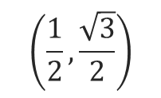
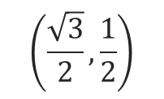






$$\left(\frac{\sqrt{2}}{2},\frac{\sqrt{2}}{2}\right)$$
$$\left(\frac{\sqrt{3}}{2},\frac{1}{2}\right)$$
$$30°$$
$$\frac{π}{4}$$
$$\left(\frac{1}{2},\frac{\sqrt{3}}{2}\right)$$
$$−\frac{π}{4}$$
$$\frac{π}{3}$$
$$\frac{10π}{3}−\frac{6π}{3}=\frac{4π}{3}$$

Slide 43

Practice: Other Trig Functions (1-4)
Compute the following.
$\sec\left(\frac{5π}{6}\right)$
$\csc\left(−\frac{7π}{4}\right)$
$\cot\left(\frac{5π}{3}\right)$
$\cot\left(135°\right)$
$$\left(0, 1\right)$$
$$\left(\frac{1}{2},\frac{\sqrt{3}}{2}\right)$$
90° = $\frac{π}{2}$
$$\left(\frac{\sqrt{2}}{2},\frac{\sqrt{2}}{2}\right)$$
60° = $\frac{π}{3}$
45° = $\frac{π}{4}$
$$\left(\frac{\sqrt{3}}{2},\frac{1}{2}\right)$$
30° = $\frac{π}{6}$
0° = 0
$$\left(1, 0\right)$$

Slide 44

Practice: Other Trig Functions (5-8)
Compute the following.
$\csc\left(\frac{5π}{4}\right)$
$\cot\left(−\frac{5π}{3}\right)$
$\csc\left(3π\right)$
$\sec\left(\frac{7π}{2}\right)$
$$\left(0, 1\right)$$
$$\left(\frac{1}{2},\frac{\sqrt{3}}{2}\right)$$
90° = $\frac{π}{2}$
$$\left(\frac{\sqrt{2}}{2},\frac{\sqrt{2}}{2}\right)$$
60° = $\frac{π}{3}$
45° = $\frac{π}{4}$
$$\left(\frac{\sqrt{3}}{2},\frac{1}{2}\right)$$
30° = $\frac{π}{6}$
0° = 0
$$\left(1, 0\right)$$

Slide 45










Triangle Area
If we know the length of 2 sides of a triangle and the included angle between the sides, then the area may be found using the following formula.
$$A=\frac{1}{2}ab\sin\left(θ\right)$$
Find the area of an equilateral triangle with 12 inches sides.
$$a$$
$$h$$
$$h$$
$$a$$
$$θ$$
$$θ$$
$$\overline{θ}$$
$$b$$
$$b$$

Slide 46






$$A=\frac{1}{2}bh$$
$$h$$
$$b$$
$$12$$
$$60°$$
$$12$$

